Slide 1
IST 687 - Final Project Presentation
Recommendations to minimize Hotel Cancellations
Aditya Shah, Manan Vora & Yash Shimpi
Notes:
https://zoom.us/j/96418673573?pwd=Uk14WVBQRld6aXFndUUwb0pvenJjUT09

Slide 2
Addressing the assumptions
Does the lead time affect cancellation? Does a higher lead time mean more possibility of cancellation?
Does staying in a weeknight contribute to the cancellations owing to the shift and work schedule?
Do meals have a relationship with cancellation?
Online tour agents provide security and flexibility to customers. Does this contribute to cancellation?
Notes:
Lead Time refers to the Number of days between booking and the arrival date
People have busy schedules during week. Does that affect their bookings?
Do the meal preferences at our hotel affect the customers cancelling
TA they act as a middleman between hotel and customer and thus provide a flexibility of change and security to their booking.

Slide 3
Addressing the assumptions
Transient customers are more flexible with their schedule and tend to change their plans quicker than a group. Does this trend is reflected in the data as well?
The higher the number of special requests made by the customers, the more inclined the customer is to come to a hotel. So, if the person does not make any request or only a few, is he more likely to cancel?
Is a repeated customer less inclined to cancel than someone who is new?
If the assigned room is different from the reserved room, does that make the customers cancel their reservation?
Notes:
Transient guests are further broken up into three different categories based on how they book: walk-ins (those who arrive at the hotel and pay the day rate at the front desk), online reservations (usually made directly through the hotel’s website), and phone reservations.
Does number of special request made directly affect customer desire to stay in the hotel
If you have repeated customers, they can be loyal to the hotel and not cancel
If customers do not get the rooms that they want, will they cancel?

Slide 4
Identification of Key Metrics
To minimize hotel cancellation, we conducted our research by building 4 Models which help us determine the best model.
Two models showed us an accuracy greater than 80%
That helped us understand the key metrics that should be addressed first.

Slide 5
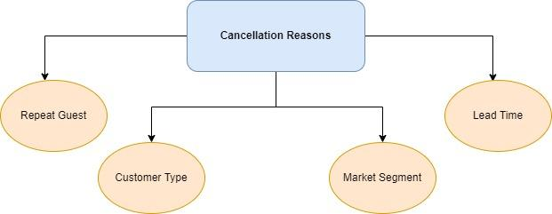
Top 4 Metrics
Notes:
In the following slides, we will

Slide 6
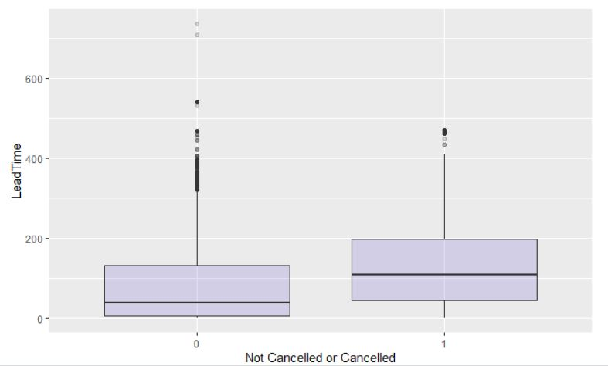
Lead Time v/s Cancellation
Notes:
This can be interpreted as higher lead times leading to more cancellations from customers.

Slide 7
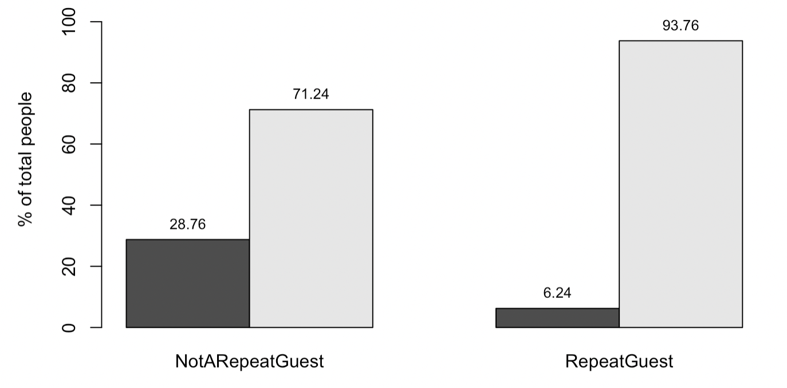
Repeat Guest v/s Cancellation
Cancelled
Not
Cancelled

Slide 8
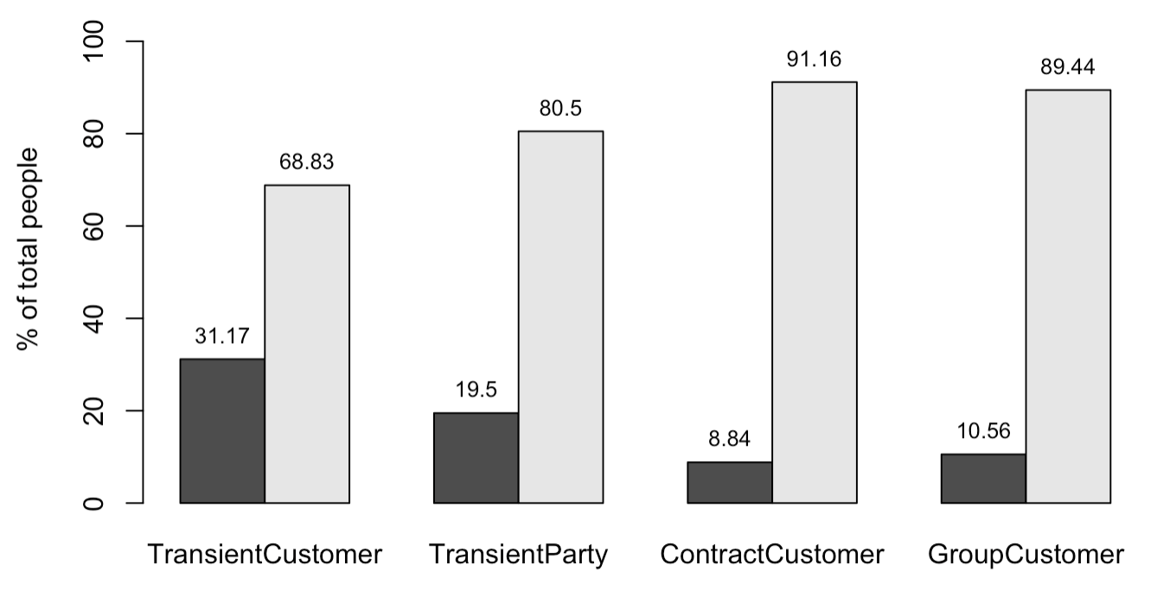
Customer Type v/s Cancellation
Cancelled
Not
Cancelled

Slide 9
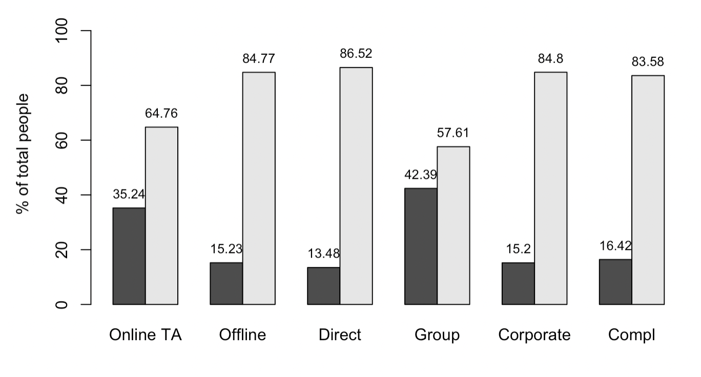
Market Segment v/s Cancellation
Cancelled
Not
Cancelled

Slide 10
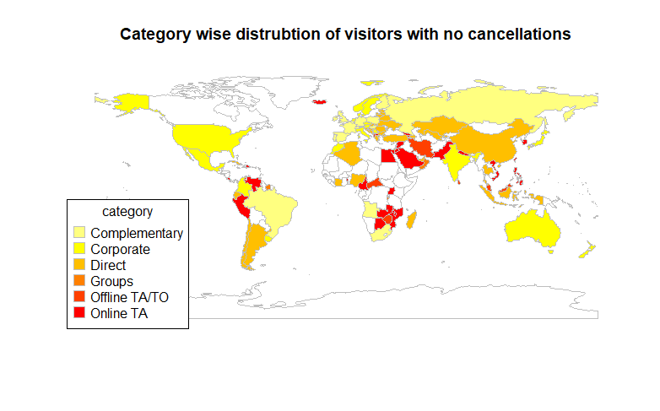
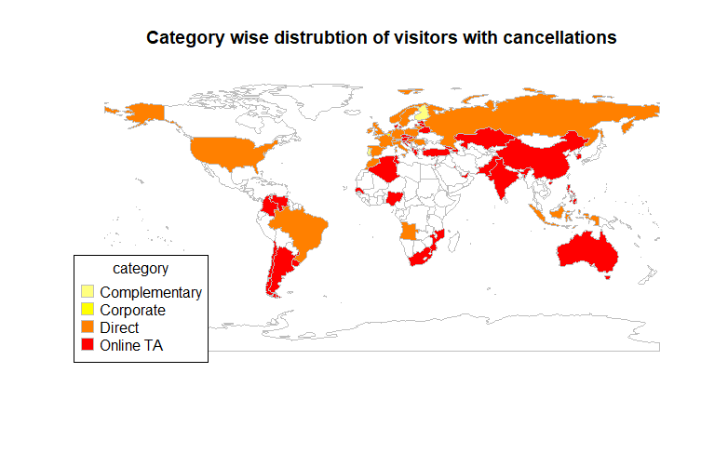
Most Corporate People or People who got complementary stay do not cancel
People who booked hotel via Travel Agents seem to cancel the booking

Slide 11
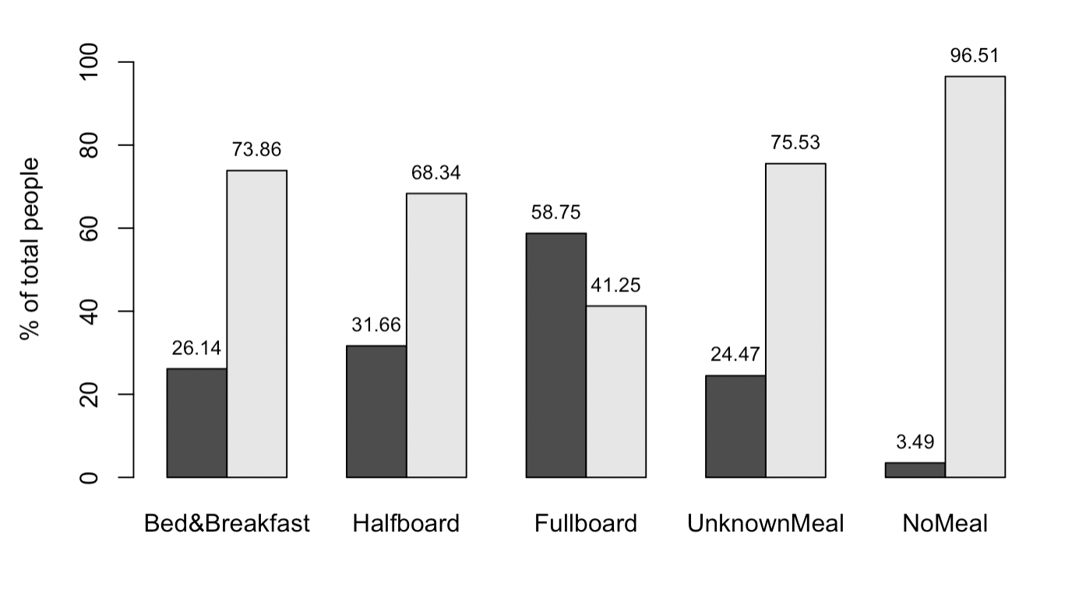
Does Meal Affect Cancellation?
Cancelled
Not
Cancelled
Notes:
The representation shows that the more the number of meals, the greater is the chance of cancellations. This is a trend that is seen in the data which is a little difficult to explain logically. It could be a consequence of having to commit greater amount of time to staying in hotel which might make customers not be able to abide to a booking in case of change in plans.

Slide 12
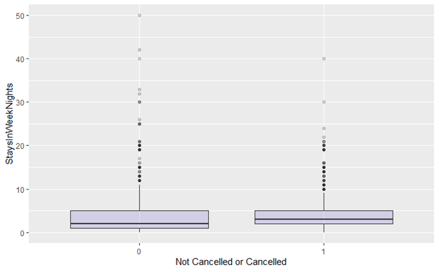
Do people cancel their booking more during weeknights ?
Notes:
The representation shows that the more the number of meals, the greater is the chance of cancellations. This is a trend that is seen in the data which is a little difficult to explain logically. It could be a consequence of having to commit greater amount of time to staying in hotel which might make customers not be able to abide to a booking in case of change in plans.

Slide 13
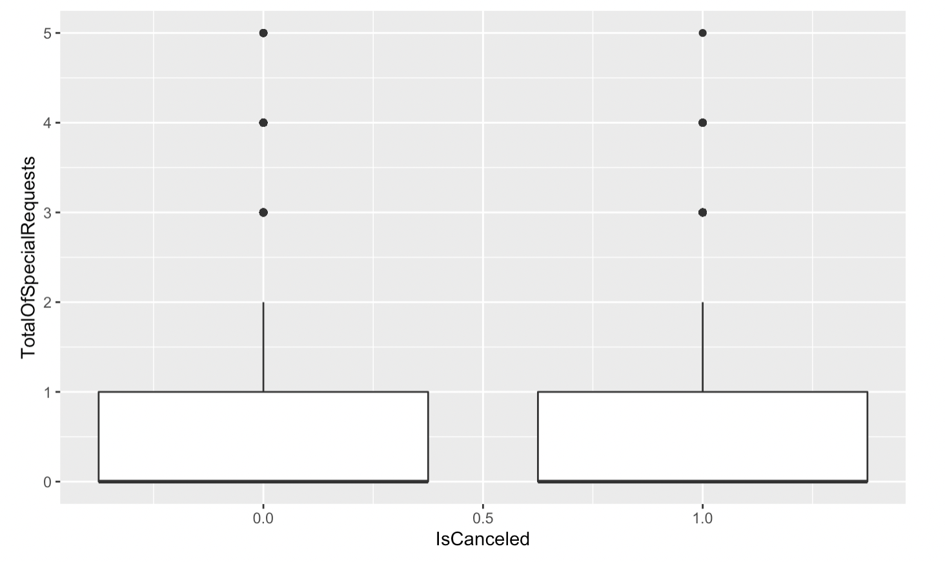
Does Special Request have any effect on Cancellation?
Notes:
It can be thought that fulfilling as many special requests as possible of the customers could convince them to not cancel their bookings. However, the data shows that there is no difference between the cancellation trends between customers with various number of special requests. The means of special requests of those customers who have cancelled and those who haven’t is the same.

Slide 14
What actions could be taken?
We have to retain a guest, so setting up a loyalty program to retain them can be useful.
Transient customers seem to cancel more than others. To attract them we can run a promotional deals or offer the stay are a cheaper price than others.
For minimizing the cancellation of groups that are booked via Travel Agents, we can set up free amenities like a gym, pool area, recreational area, free high-tea, food or beverages to a certain limit so that they can enjoy their stay in the hotel.
Since higher lead time can lead to change in plans, we should be allowing bookings 3 months prior to the check in date only.

Slide 15
Other important recommendations
Although assigned rooms and reserved rooms do not play much part in cancellation, by finding patterns we notice that people that are associated with rooms H, G, and C assigned tend to cancel their bookings. Maybe changing the layout of room can be useful here.
Since our hotel has guest from all around the world, we can have themes or cuisines that is consistent with that country so that they feel more convinced to come at our hotel and they enjoy their stay.

Slide 16
Thank you!
Notes:
https://zoom.us/j/93486960390?pwd=MGNZYk1GUDNTOXpmcWliR29KUWVWdz09

